Slide 1

MBE 713 Fisheries stock assessment part 1: Surplus production models
Elizabeth A. Babcock
Marine Biology and Ecology

Slide 2
Goal of Fisheries Management
Keep biomass is high enough and the catch low enough that the fishery can be sustained indefinitely.
This point is called the target biomass and fishery mortality rate.
Biomass relative to target B/B_{target} and fishing mortality rate relative to target F/F_{target} are indicators of the status of the fishery.

Slide 3
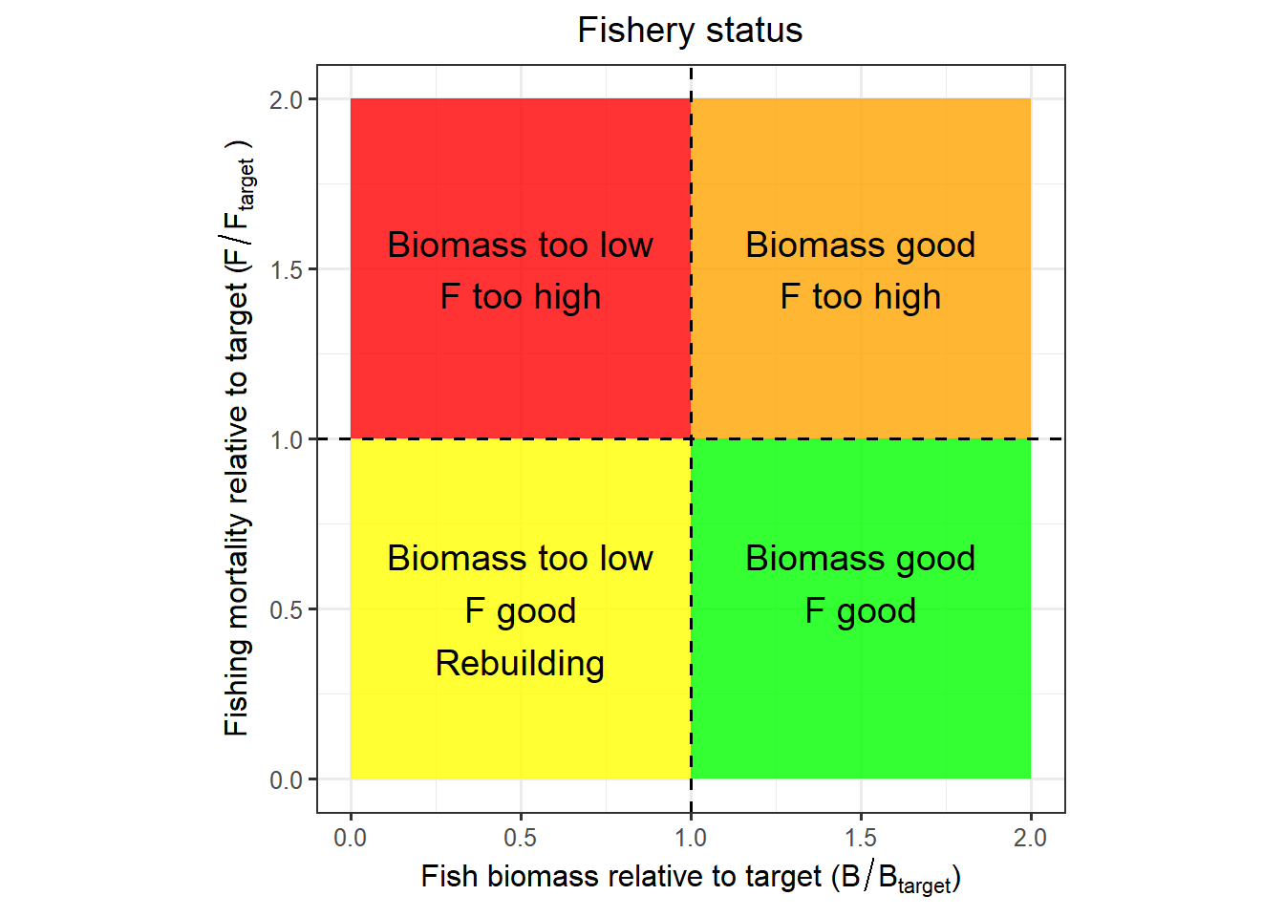
Visualized in a Kobe plot

Slide 4
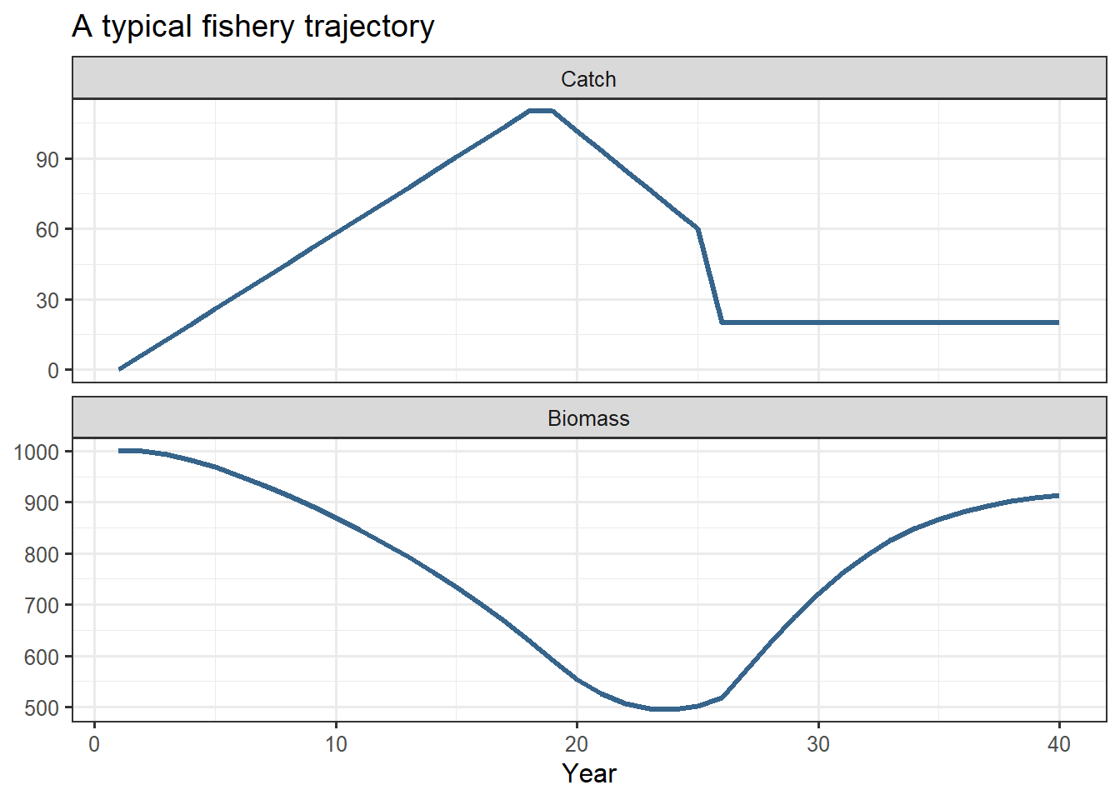
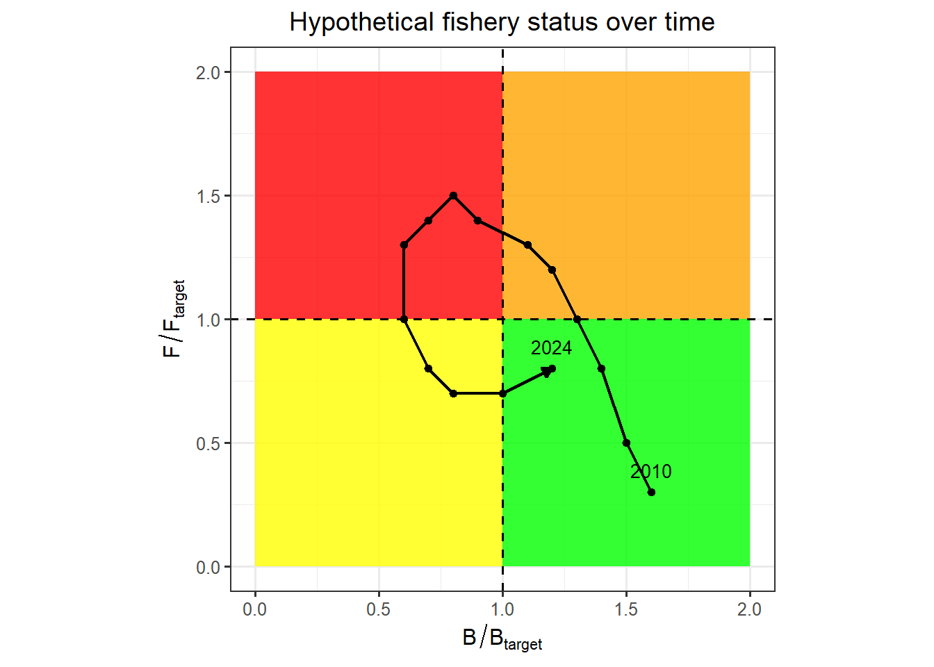
Hypothetical fishery

Slide 5
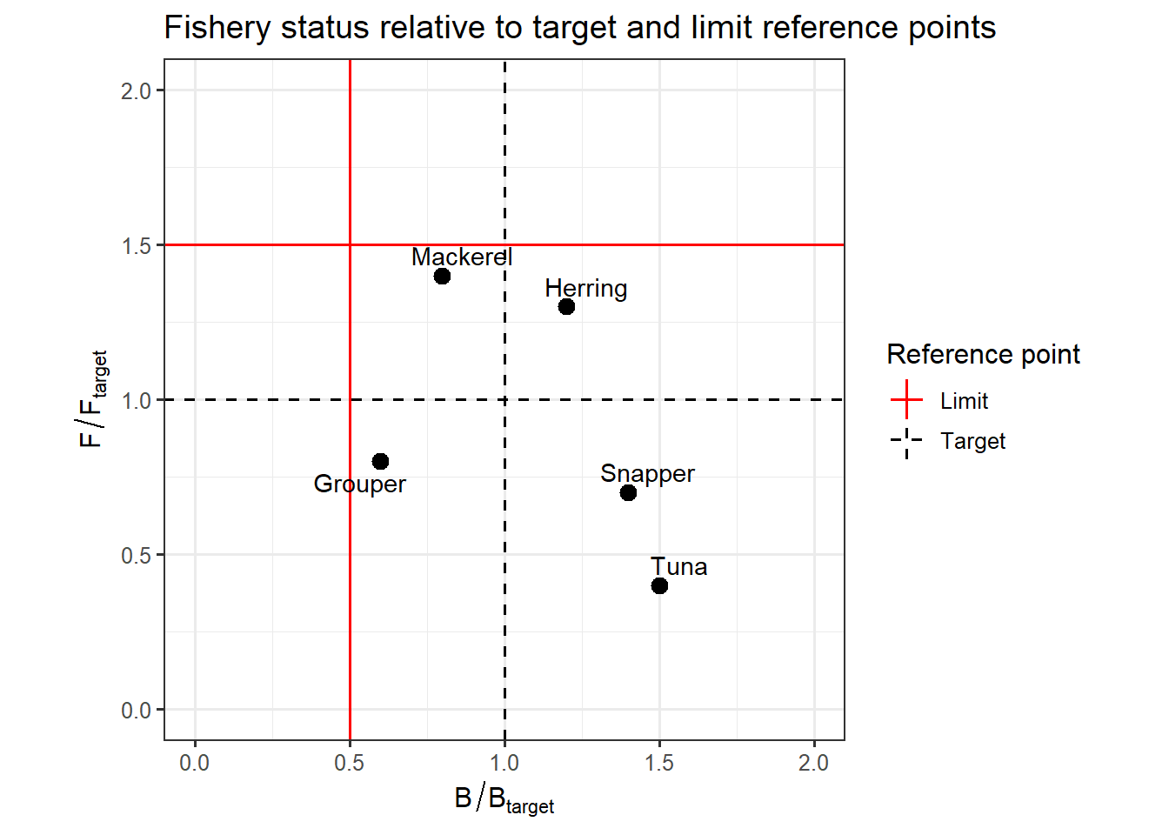
Indicators and reference points
In the US, we have both target and limit reference points, where targets are the goal of management but limits trigger more management action.

Slide 6
For protected species
Instead of something like MSY, calculate Potential Biological Removal which is the number that can be killed without jeopardizing recovery (e.g. in bycatch, ship strikes).
BPR is a reference point, but not a target or a limit reference point, because the goal is always lower mortality and more recovery

Slide 7
Stock assessment methods
For data poor fisheries some ad-hoc methods based on limited data
If catch and an index of abundance, surplus production models
With more data, statistical catch at age models

Slide 8
Surplus production model
Simplest population dynamics model used for stock assessment
Often used in data poor fisheries, where size or age composition data is lacking
Based on logistic population growth,
Can use demographic methods to inform population growth rate (r) parameter

Slide 9
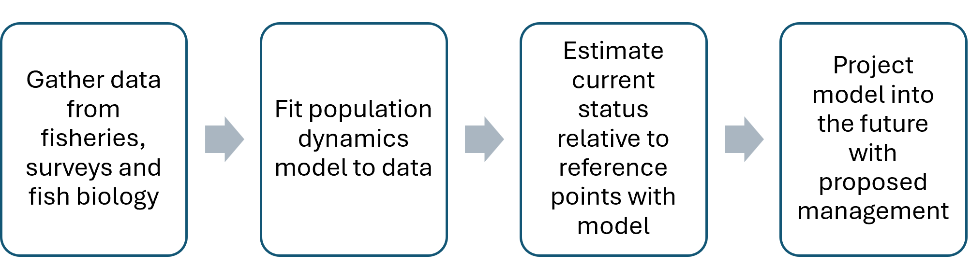
Fisheries stock assessment
Diagnostics, testing
Status determination and projections include uncertainty, so we can calculate the probability of meeting a target or avoiding limits

Slide 10
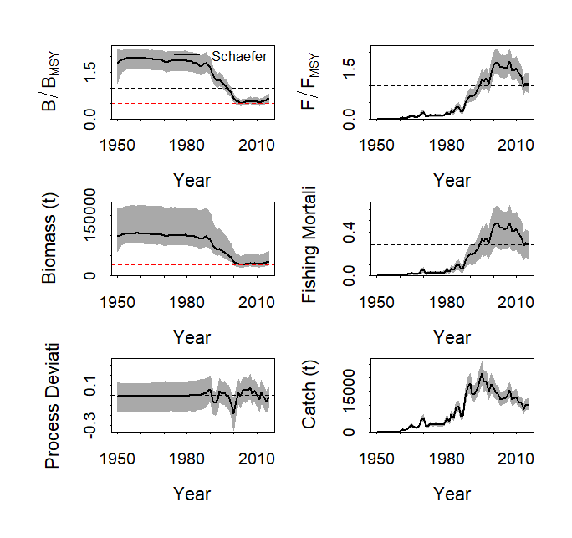
B/Bmsy and F/Fmsy for South Atlantic Swordfish

Slide 11
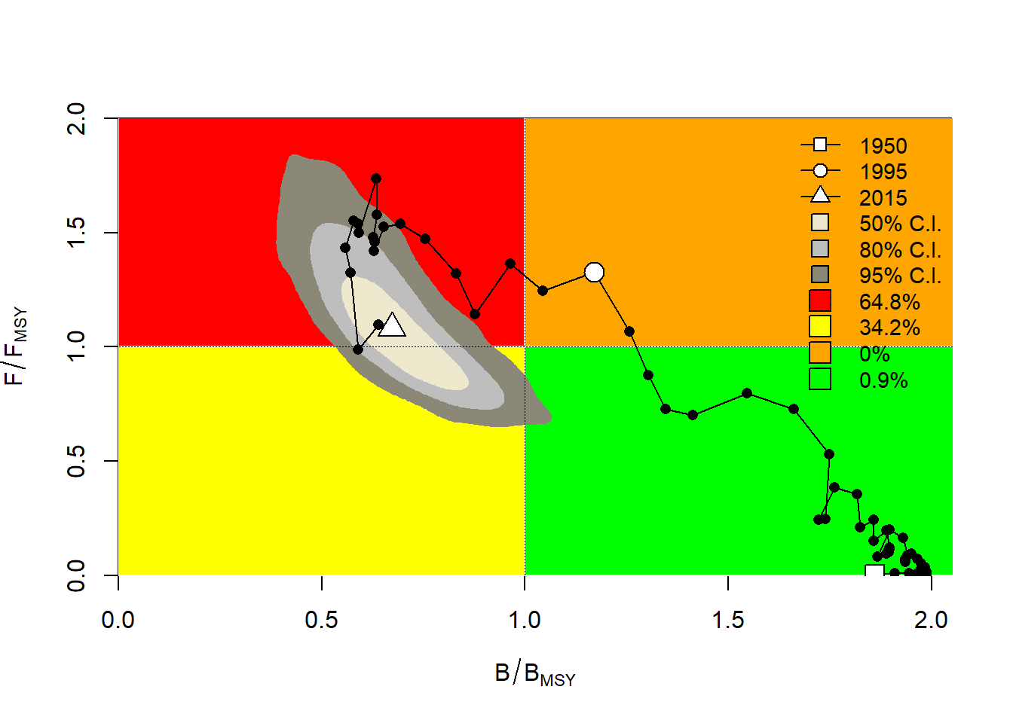
Kobe plot

Slide 12
Surplus production model yield curve
r is the rate of increase at low population size
K is the unfished population size
Biomass B calculated

Slide 13
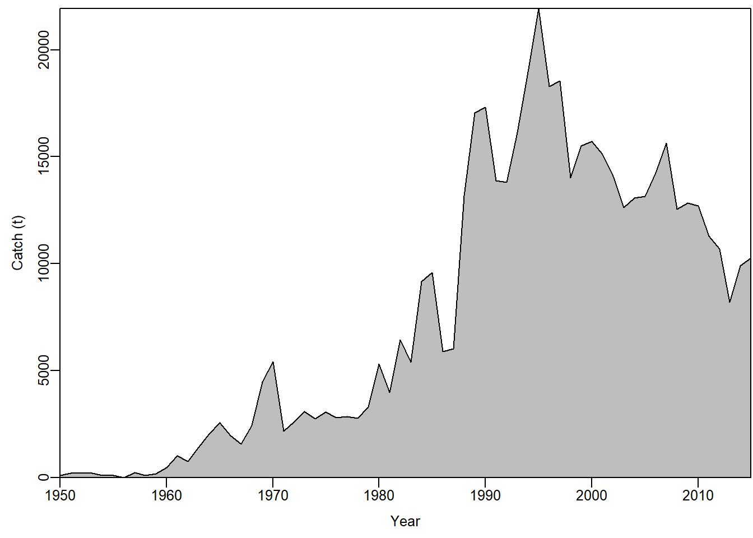
Swordfish south Atlantic catch
JABBA demo

Slide 14
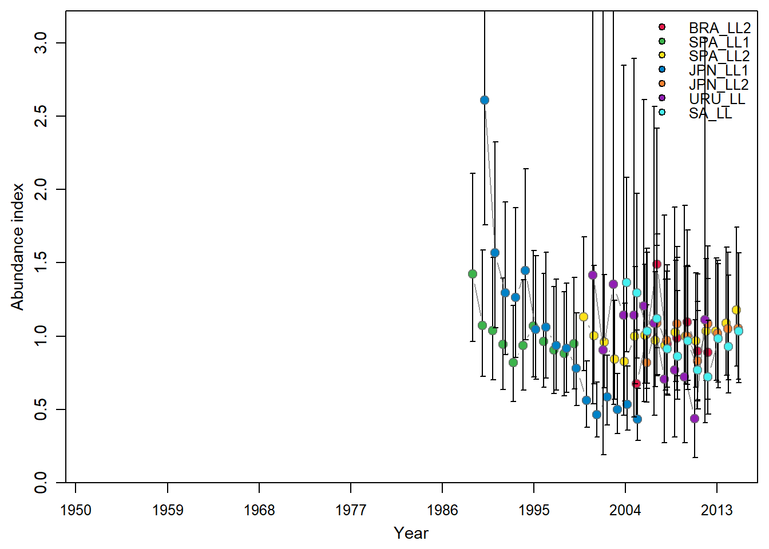
Swordfish south Atlantic CPUE

Slide 15
Deterministic version
State variable Biomass (B) is:
Assume CPUE index (I) is proportional to B
Likelihood is
Parameters with priors: r, K, B in the first year and σ_{j}² and q_{j} for each series.
Sigma σ is called Observation error
I_{j} ~lognormal(q_{j}B_{t} , σ)

Slide 16
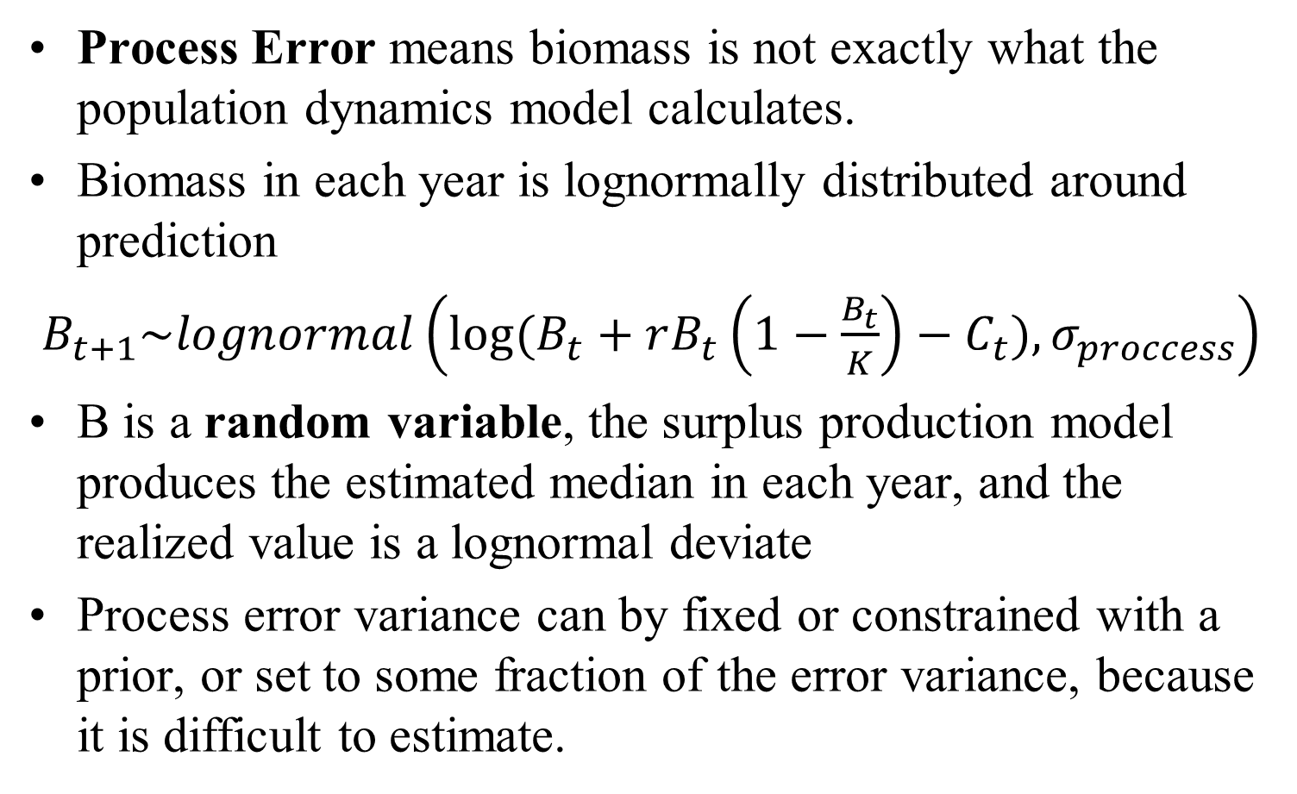
Adding process error to state variable
Process Error means biomass is not exactly what the population dynamics model calculates.
Biomass in each year is lognormally distributed around prediction
$B_{t+1}\sim lognormal\left(log⁡(B_{t}+rB_{t}\left(1−\frac{B_{t}}{K}\right)−C_{t}), σ_{proccess}\right)$
B is a random variable, the surplus production model produces the estimated median in each year, and the realized value is a lognormal deviate
Process error variance can by fixed or constrained with a prior, or set to some fraction of the error variance, because it is difficult to estimate.

Slide 17
Bayesian estimation
Bayesian statistics use prior information to constrain the values of parameters in plausible bounds
Most modern fisheries stock assessment models do this is some way, because we have biological information
K and r must be in a range of plausible values, or the population would be either extinct or exploding in size

Slide 18
Bayesian estimation
Bayesian models define parameter uncertainty as a probability density function (pdf).
The pdf of a parameter before the model is fitted to data is called the prior
The priors are multiplied by the likelihood of the data given the parameters to get the posterior
Posterior=prior*likelihood

Slide 19
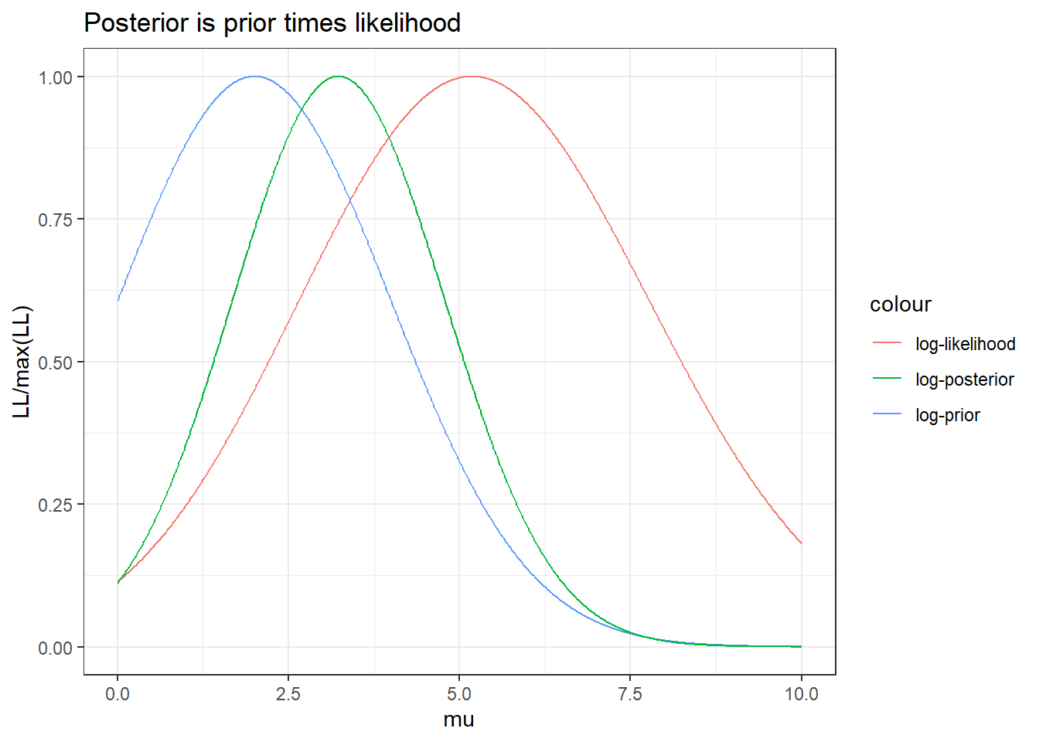
Example to estimate a normal mean with informative prior

Slide 20
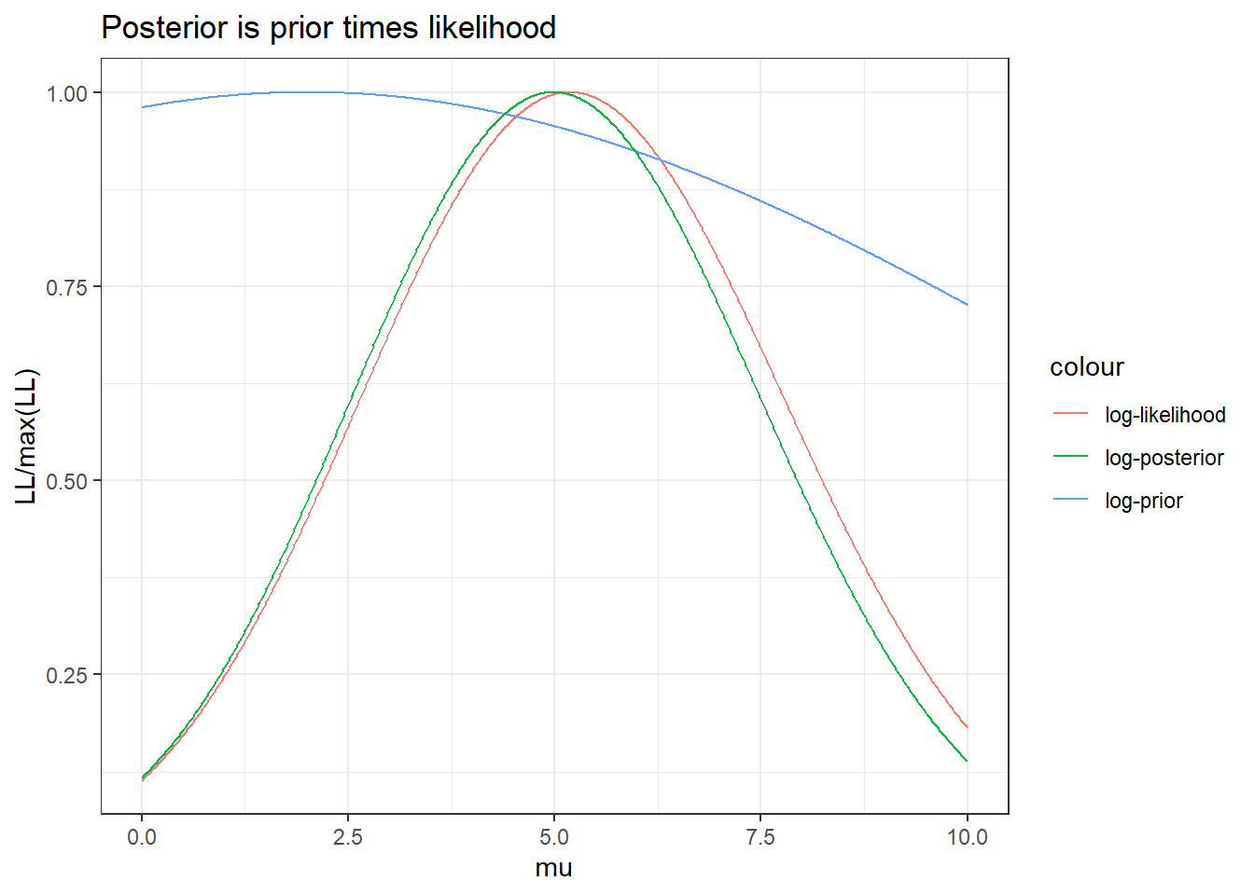
With a vague prior

Slide 21

In log terms
Log-posterior of parameters is
log(posterior) = log(prior) + log(likelihood)
$$\log\left(P\left(θ | y\right)\right)=\log\left(P\left(θ\right)\right)+P\left(y | θ\right)$$

Slide 22
Bayesian production model
Log-posterior of parameters is
log(posterior) = log(likelihood)+log(Prior-r) +log(Prior-K)+log(Prior-B0/K)+log(Prior-q) +log(prior-sigma)
Calculations are done using a numerical integration process called Markov Chain Monte Carlo (MCMC)
For Bayesian models
define the priors.
Make sure MCMC has converged on the final posterior distribution

Slide 23
Bayesian workflow
Define the model setup
Distributions to use for likelihood and priors
Prior mean and sd values, MCMC settings
Run MCMC and check for convergence
Parameter estimates should oscillate around mean in each MCMC chain, smooth posterior density plots
Check for model fit and adequacy
Residuals, posterior predictive checks, etc.
Use a sample from the posterior (called MCMC draws) to calculate posterior density plots, means, standard deviations, quantiles, etc.
Project into the future

Slide 24
Kinds of priors
Vague or diffuse, widely distributed so they don’t influence the output much
Informative, based on data such as
Population biology (number of births, deaths, etc.)
Information on expected total magnitude of the population from catches
Comparison with other populations

Slide 25
For production model
Mean and sd for r can come from demographic analysis
K is probably not much more than 10 times the total catch over the time series
B0 is centered on K if the data go back to the beginning of the fishery
Weakly informative values for q, sigma

Slide 26
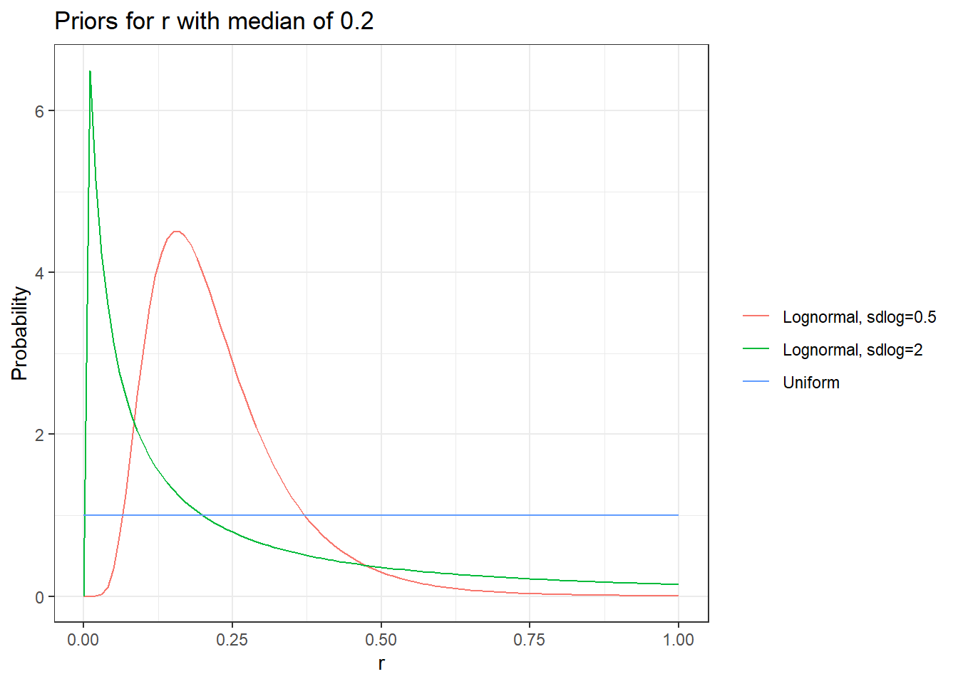

Slide 27
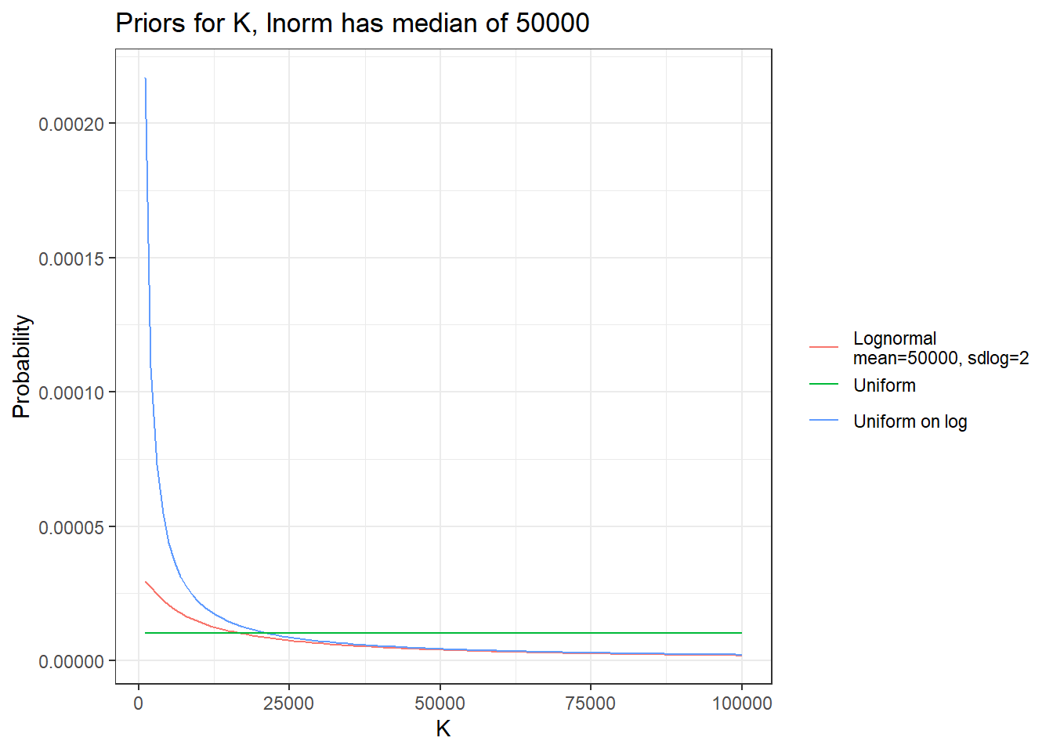

Slide 28
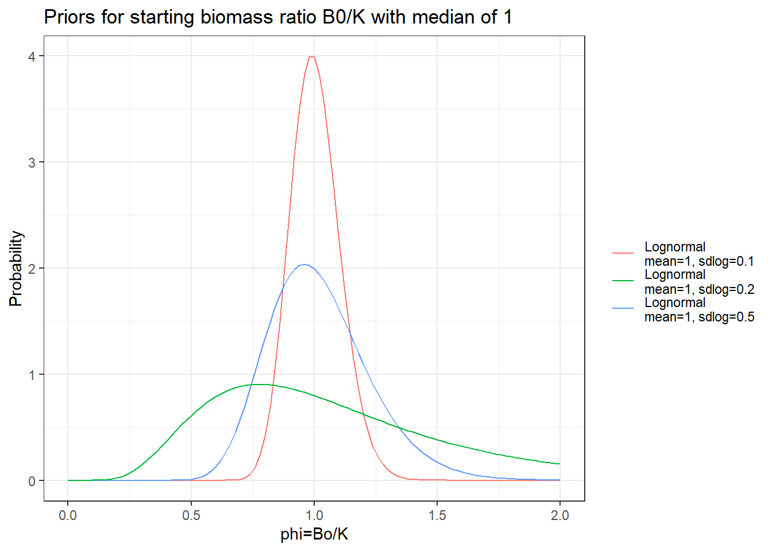

Slide 29
Treatment of uncertainty
Bayesian method works by drawing a random sample of the posterior distribution
Each random draw is one trajectory of the population.
The credible interval of B/Bmsy, etc. is the 2.5% and 97.5 quantiles of the posterior
Probabilities, e.g. P(B>Bmsy) is fraction of random draws where B>Bmsy

Slide 30
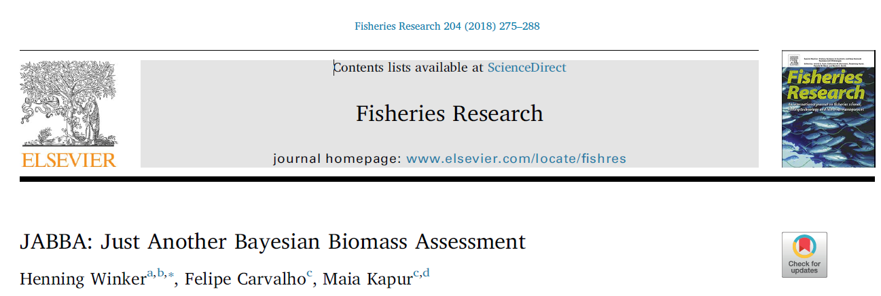
JABBA
https://github.com/jabbamodel/JABBA

Slide 31
Using JABBA
JABBA is an R package that runs a Bayesian surplus production model in a Bayesian MCMC program called JAGS.
JABBA is widely use for stock assessment
It has default priors and settings built in, but you should enter your own.
JABBA has functions to make a lot of plots and diagnostic checks, do projections, etc.

Slide 32
JABBA functions
build_jabba() sets up all the inputs
fit_jabba() runs the JAGS MCMC
fw_jabba() does forward projections
hindcast_jabba does hindcast cross-validation and retrospective analysis
jbplot_[plot type] functions do a lot of plots and summaries.

Slide 33
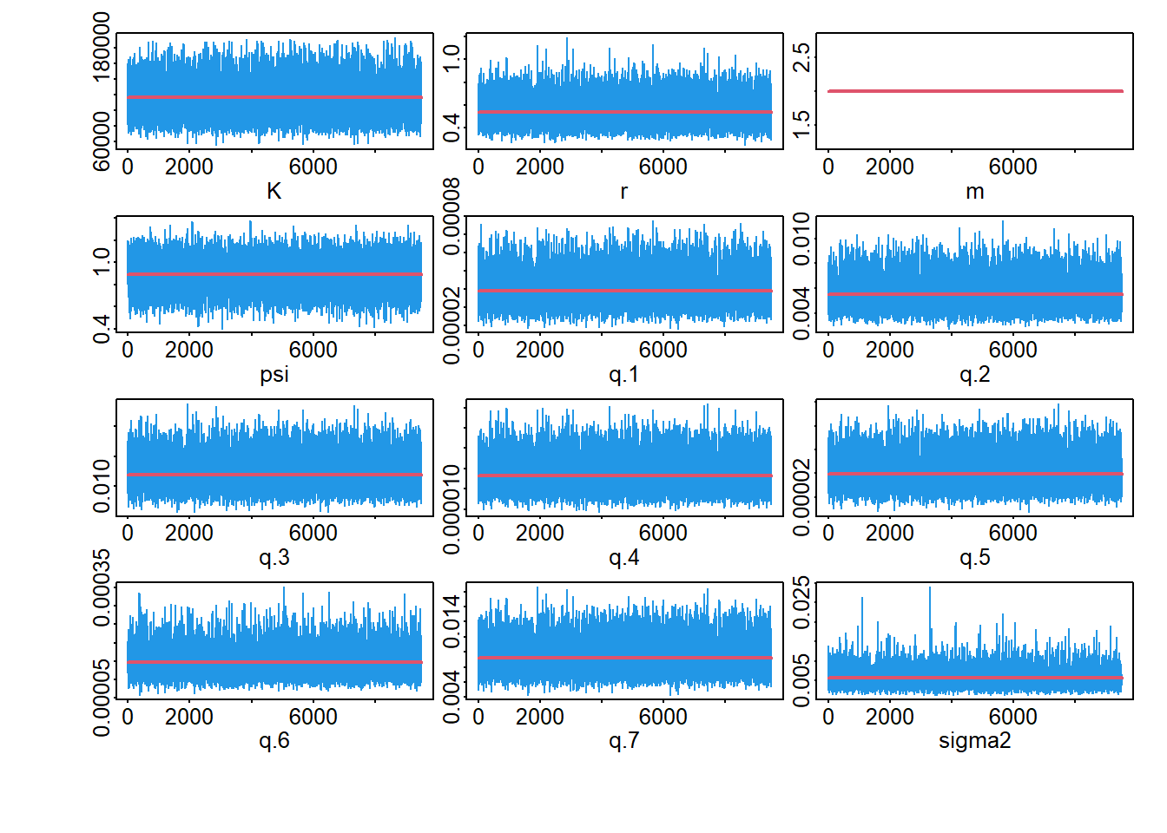
Check MCMC convergence
Should oscillate with no pattern

Slide 34
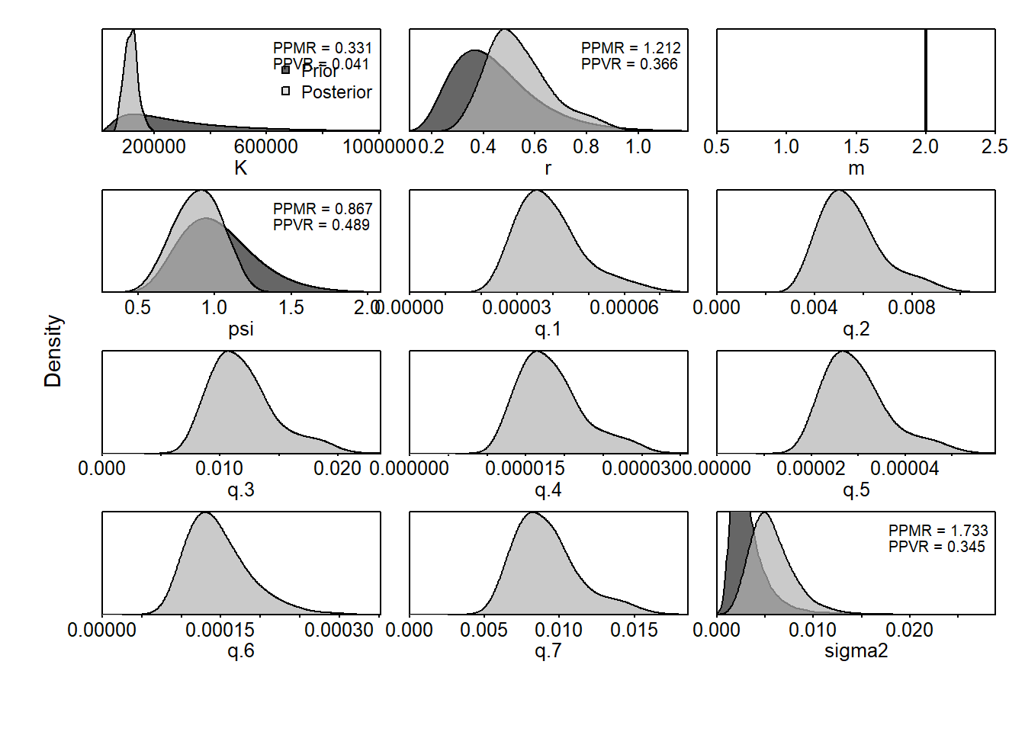
Compare prior and posterior
Should look smooth
Notice the difference between prior and posterior

Slide 35
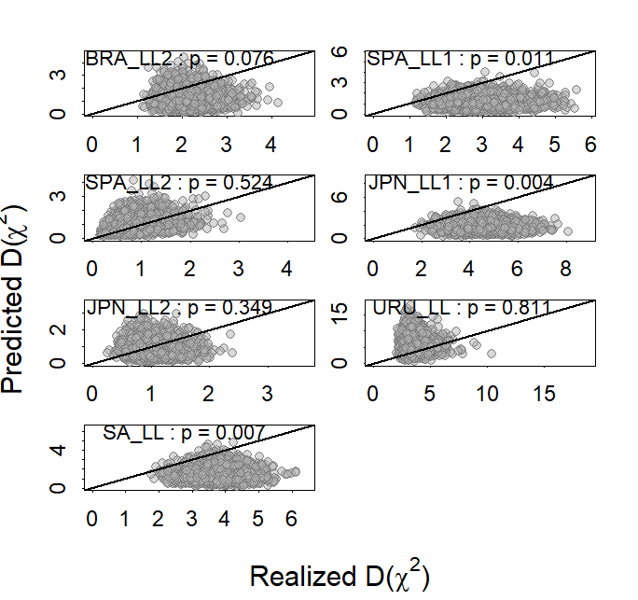
Posterior predictive checks
Compares squared standardized residuals (Realized) to the same from data simulated from the model (Predicted).
Should be even spread around line, with the fraction of points above the line p=0.5

Slide 36
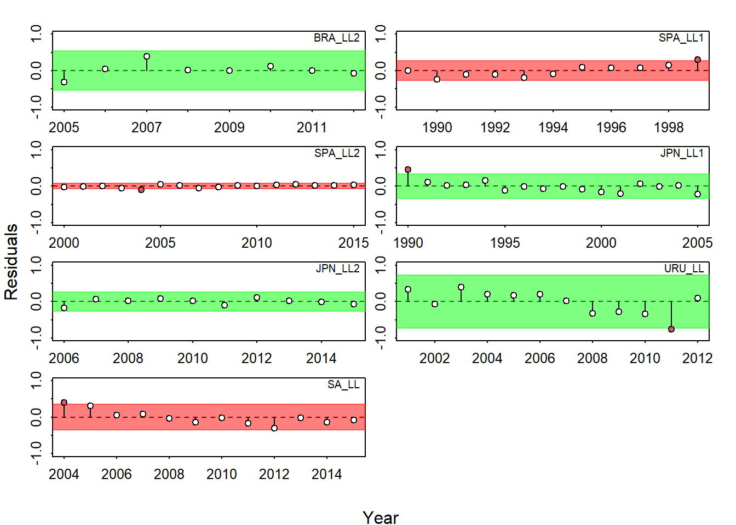
Runs test on residuals
Checks for patterns or outliers in residuals.
Green is good

Slide 37
Retrospective analysis
Re-fit the model ending, 1 year earlier, 2 years earlier, etc. Look for consistent trends
Sometimes assessments will consistently over or underestimate current biomass, biasing management advice.

Slide 38
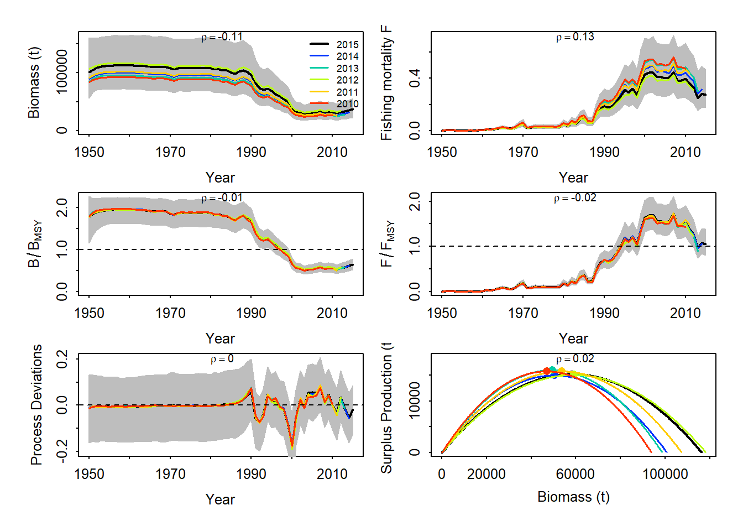
Retrospective (back 1-5 years)
No red flags

Slide 39
Hindcast cross-validation
Cross-validation means
Fit the model to only some of the data (training data)
Use the model to predict the left out data (test data)
Calculate how well model predicts the test data
Hindcast cross validation predicts last 1-5 years of CPUE from the data up to the previous year (same runs as retrospective)

Slide 40
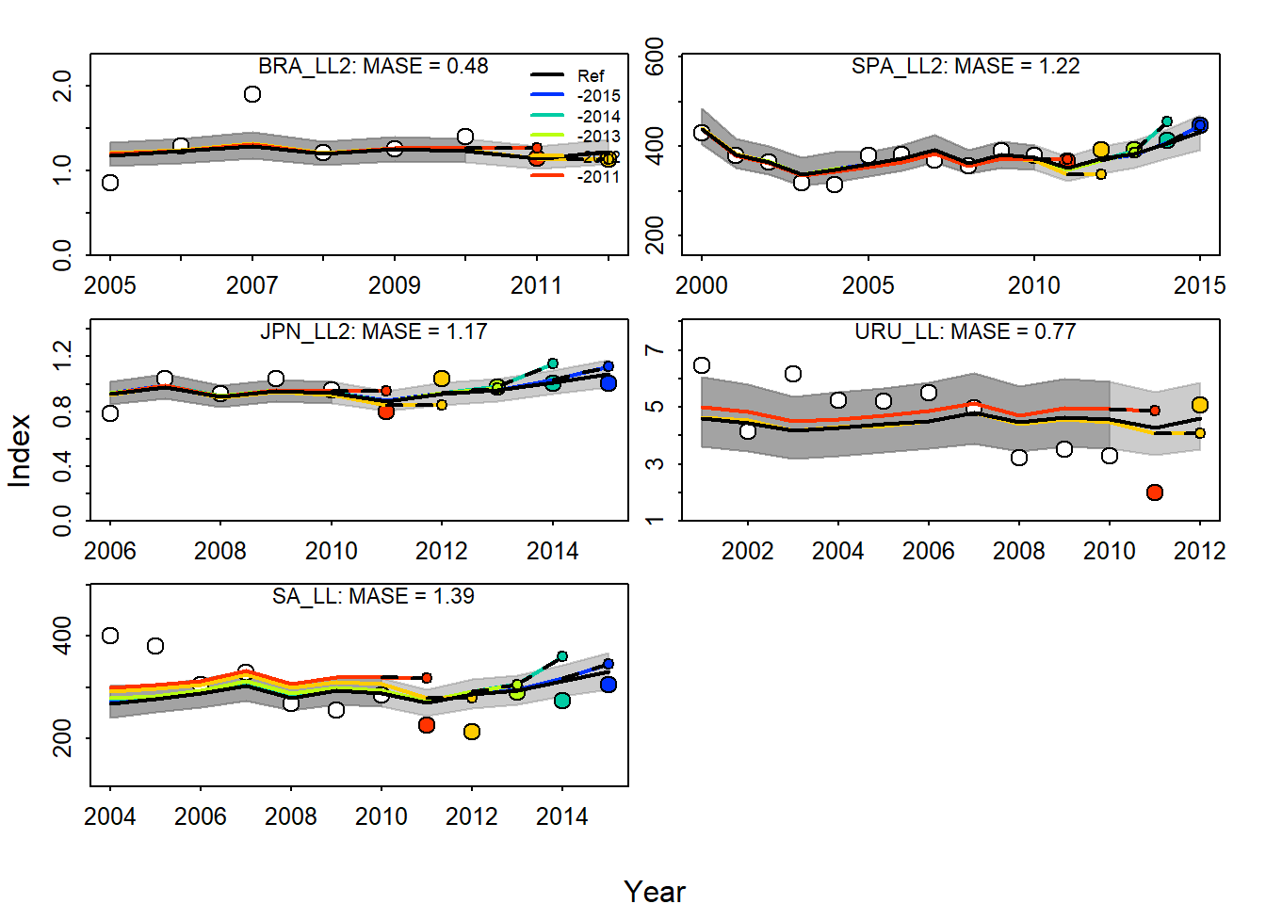
Hindcast cross-validation
Lines are predictions, circles are real CPUE data
No obvious patterns

Slide 41
Kobe plot

Slide 43
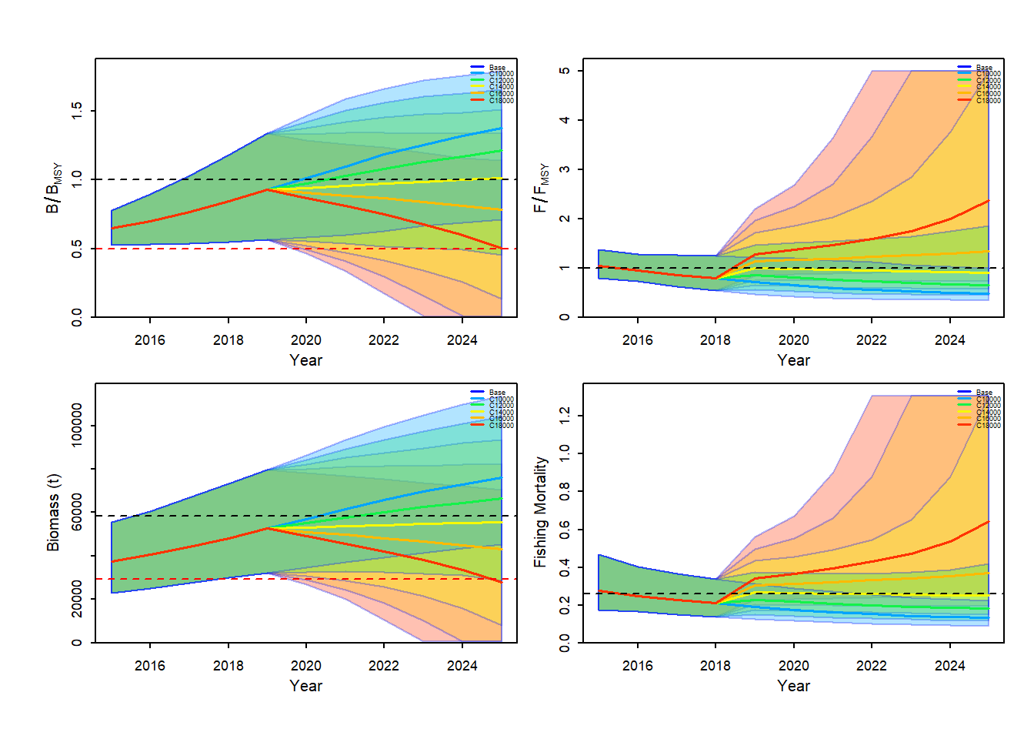
Projections

Slide 44
Pella model
The Pella Tomlinson model allows for the shape of the yield curve to be asymmetric. Bmsy/K is either fixed or an estimated parameter
Commonly used in assessment because it is more flexible.

Slide 45
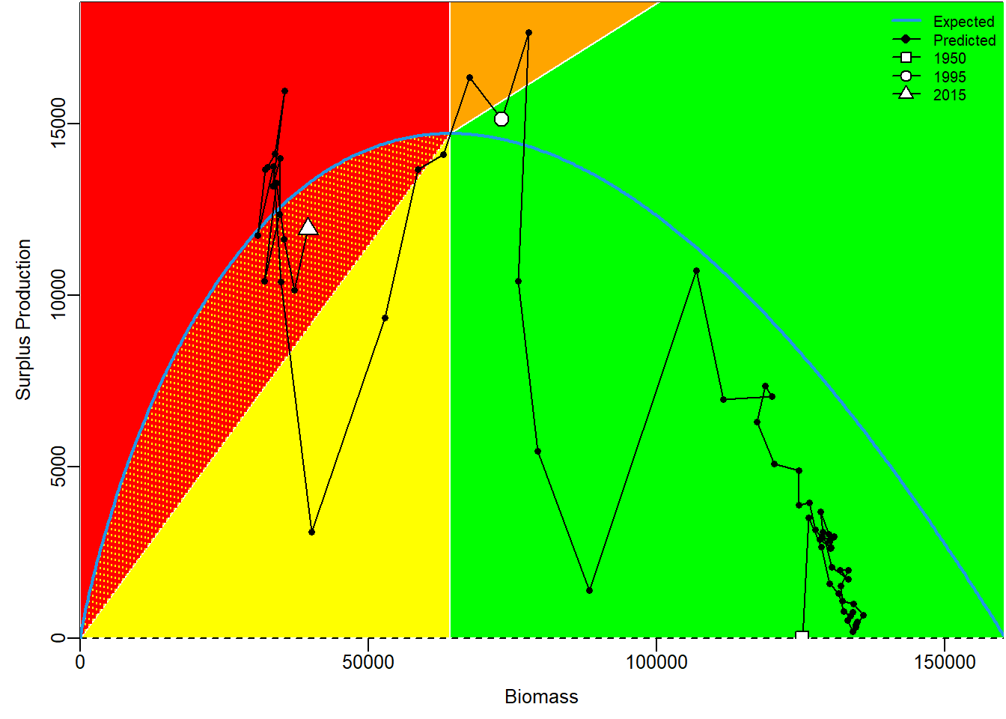
Pella yield curve

Slide 46
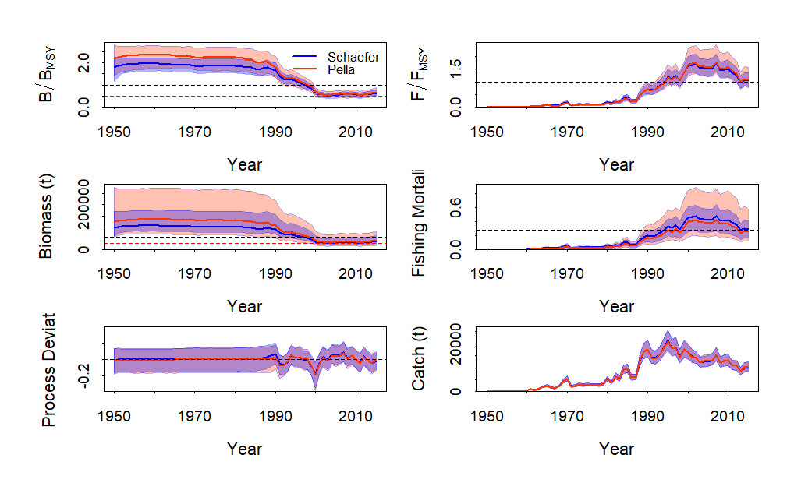
Pella vs. Schaefer

Slide 47
References
Winker, H., Carvalho, F., and Kapur, M.. 2018. JABBA: Just Another Bayesian Biomass Assessment. Fish. Res. 204:275–288. https://doi.org/10.1016/j.fishres.2018.03.010
Carvalho, F., Winker, H., Courtney, D., Kapur, M., Kell, L., Cardinale, M., Schirripa, M., Kitakado, T., Yemane, D., Piner, K. R., Maunder, M. N., Taylor, I., Wetzel, C. R., Doering, K., Johnson, K. F., and Methot, R. D. 2021. A cookbook for using model diagnostics in integrated stock assessments. Fish. Res. 240:105959. https://doi.org/10.1016/j.fishres.2021.105959
Babcock, E. A. 2026. Bayesian production models applied to north atlantic mako sharks using JABBA and JABBA-Select, updated in 2026. Col. Vol. Sci. Pap. ICCAT, 83(7), SCRS/2026/149: 1-23 (2026)

